Slide 1
RNTCP
B.L.TEJASWI
INTERN
JJMMC

Slide 2
A million dollar question!!!!
Which is the biggest disease today ?????

Slide 3
The biggest disease today is not leprosy or TB…
But rather the feeling of being unwanted, uncared & deserted by everybody
☹☹☹

Slide 4

ABANDONED...
In every living thing there is the desire of love….
Doesn’t she deserve a little love…a little care ????

Slide 5
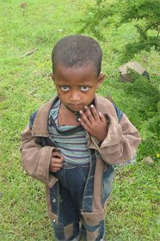
Kuyu Boja, age 5.
Kuyu's father died of TB.
Kuyu lives with her mother and two siblings. Her mother supports the household by selling onions. Kuyu's favorite pet is a hen, her favorite color is yellow, sport is running, and hobby is playing with friends. Kuyu suffers from daily stomach aches. She likes to play in her free time.

Slide 6
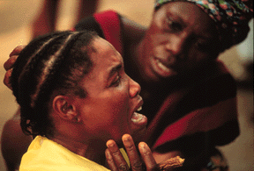
Her husband died of TB… Who have to wipe her tears????

Slide 7
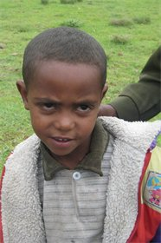
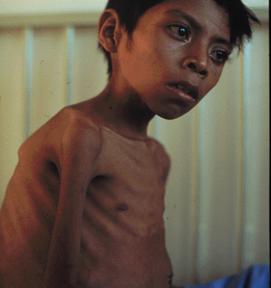
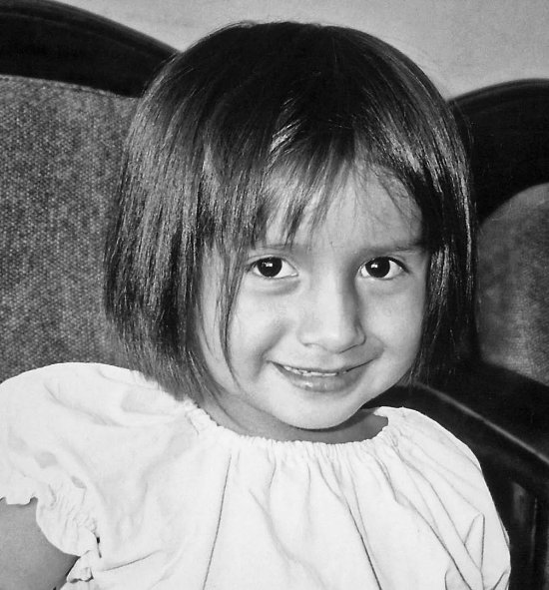
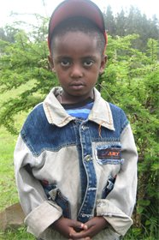

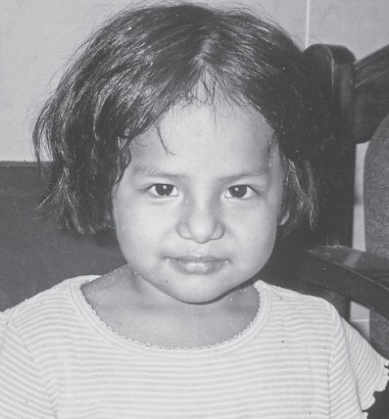
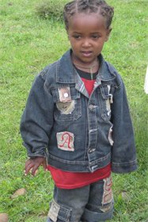

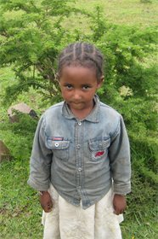
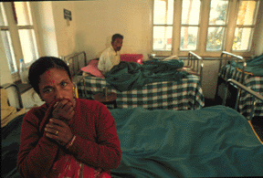
There are many!!!!!!

Slide 8
Do you know…
Every year 3,00,000 children leave their school bczz of their parents suffering from TB ☹☹
1,00,000 women are thrown out of their houses due to stigma assoc. with TB ☹ ☹
 | Incidence of disease | Prevalence of disease | Mortality | HIV prevalence among incident cases
Global | 9.4 million (139/lakh/year) | 11.1 million (165/lakh/year) | 1.32 million (19.6/lakh/year) | 15%
India | 1.98 million (168/lakh/year) | 2.18 million (185/lakh/year) | 2.76 lakhs (23/lakh/year) | 6.7%

Slide 9
India is the highest TB burden country accounting for more than one-fifth of the global incidence
Global annual incidence = 9.4 million
India annual incidence = 1.96 million
Source: WHO Geneva; WHO Report 2009: Global Tuberculosis Control; Surveillance, Planning and Financing

Slide 10


How to combat ?????
“No one ever said this would be an easy fight. We are now at the start of a road that
should take us towards the achievable goal of TB elimination”
Mario Raviglione, Director, WHO Stop TB Department

Slide 11
ntp
TB
Launched in 1962
District tuberculosis control programme
Managerial weakness
Over reliance on x ray
30% cases diagnosed
Of them 30% completing treatment
Non standardized treatment
Lack of report on outcome

Slide 12



NTP must be revised and intensified ..
NTP
NTP must be revised and intensified ..
RNTCP
Revise &intensify

Slide 13
Following 1992 review, RNTCP designed based on
internationally recommended DOTS strategy
Started on a pilot scale in 1993
From pilot project to National Programme
RNTCP launched as a national programme in 1997
Expansion was planned in a phased manner
Prior to starting service delivery, the preparatory activities in the district were certified by an appraisal mechanism.
Entire country covered under RNTCP by March’06

Slide 14
RNTCP – Goal and Objectives
Goal:
The goal of TB control Programme is to decrease
mortality and morbidity due to TB and cut transmission
of infection until TB ceases to be a major public health
problem in India.
Objectives:
To achieve and maintain a case detection of at least
70% of new sputum positive TB patients
To achieve and maintain a cure rate of at least 85% in such patients

Slide 15
strategies
DOTS (Directly Observed Treatment Short Course Chemotherapy)
Involvement of Non Government Organizations(NGO’s)
IEC( Information, Education and Communication) activities.

Slide 16
Political commitment
Diagnosis by microscopy
Adequate supply of Short course drugs
Directly observed treatment
Accountability TB Register
O
T
S

Slide 17
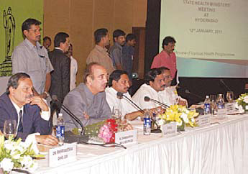
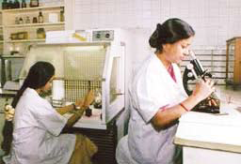
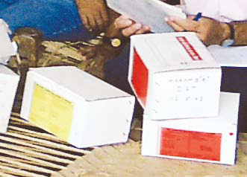
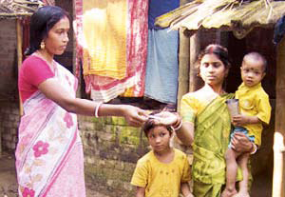

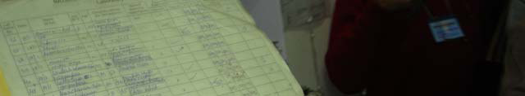


p
m
d
dot
account

Slide 18
Why Directly Observed Treatment
(DOT)?
Necessary to prevent patients from interrupting
treatment throughout the duration of treatment
Ensures that patients receive
– the right drugs
– in the right doses
– for the right duration of treatment

Slide 19
Mechanism of DOT
• DOT-provider can be anybody who is accessible and
acceptable to the patient and accountable to the health
system and who is not a family member
– Can be health care workers, ASHA, Anganwadi Workers, NGO
workers, private practitioners, community volunteers, shop keepers,
cured patients, etc.
• During intensive phase (first 2-3 months), all doses are
given to the patients under the direct observation of the
DOT provider
• During continuation phase (remaining part of treatment),
the first dose of the week is given to the patients under
direct observation of the DOT provider

Slide 20
A pulmonary TB suspect is defined as:
An individual having cough of 2 weeks or more.
Contacts of smear-positive TB patients having cough of any duration.
Suspected/confirmed extra-pulmonary TB having cough of any duration.
HIV positive patient having cough of any duration.
Sputum microscopy is the primary tool for diagnosis.

Slide 21
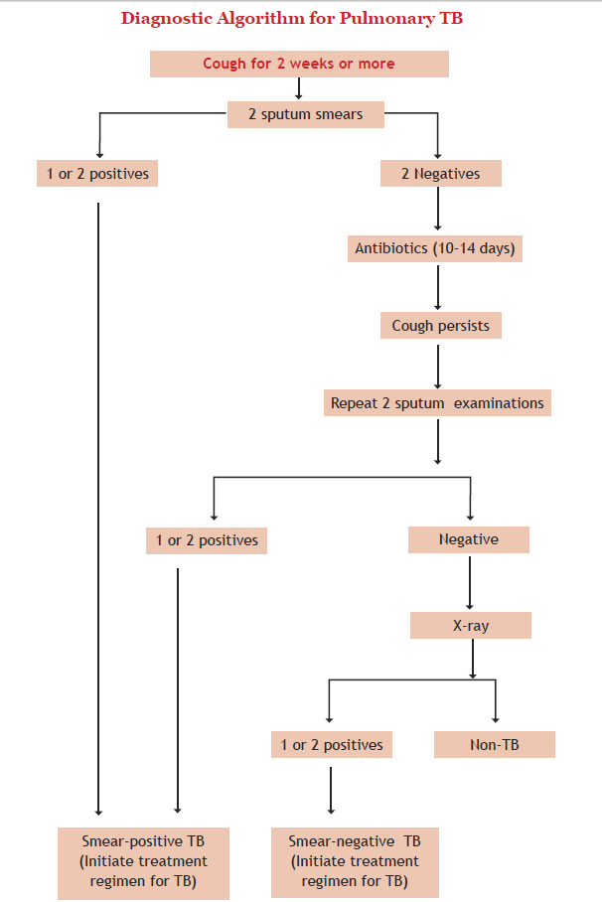

Slide 22
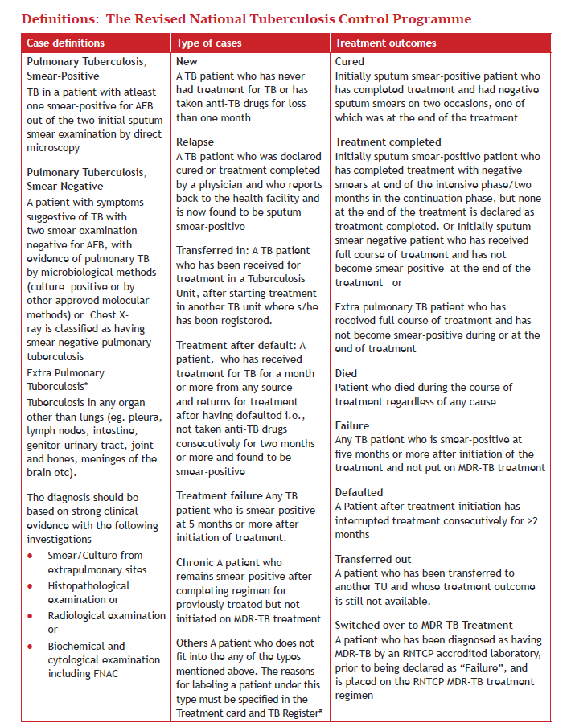

Slide 23
Treatment groups | Type of patient | Regimen
 |  | Intensive Phase | Continuation Phase
New (Cat I) | New Sputum smear-positive New Sputum smear-negative New Extra-pulmonary New Others | 2H3R3Z3E3 | 4H3R3
Previously Treated (Cat II) | Smear-positive relapse Smear-positive failure Smear-positive treatment after default others | 2H3R3Z3E3S3/ 1H3R3Z3E3 | 5H3R3E3
Patient wise Drug Boxes
Drugs are supplied in patient-wise boxes (PWB) containing the full course of treatment,
and packaged in blister packs. The PWB have a color code indicating the two regimen - Red
for “New”, Blue for “Previously Treated”. In each PWB, there are two pouches; one for
intensive phase and one for continuous phase. In the intensive phase, each blister pack
contains one day’s medication. For the continuation phase, each blister pack contains one
week’s supply of medication. The drugs for extension of the intensive phase (prolongation
pouches) are supplied separately
Regimen for New cases treatment consists of total 78 doses and for previously treated cases consists of 102 doses.

Slide 24
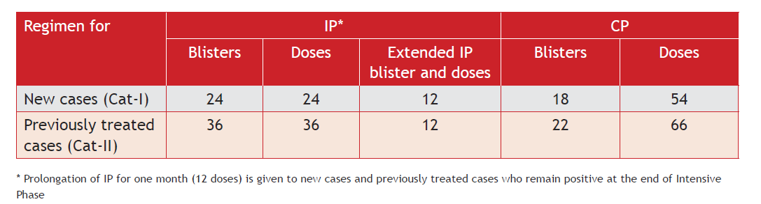
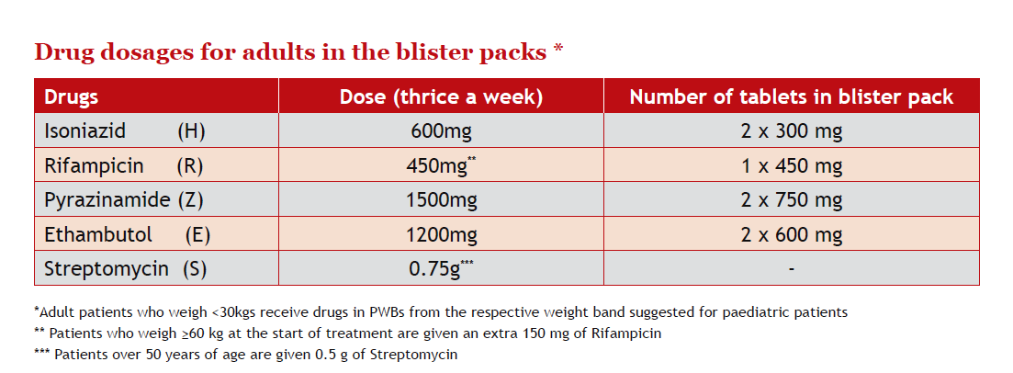

Slide 25
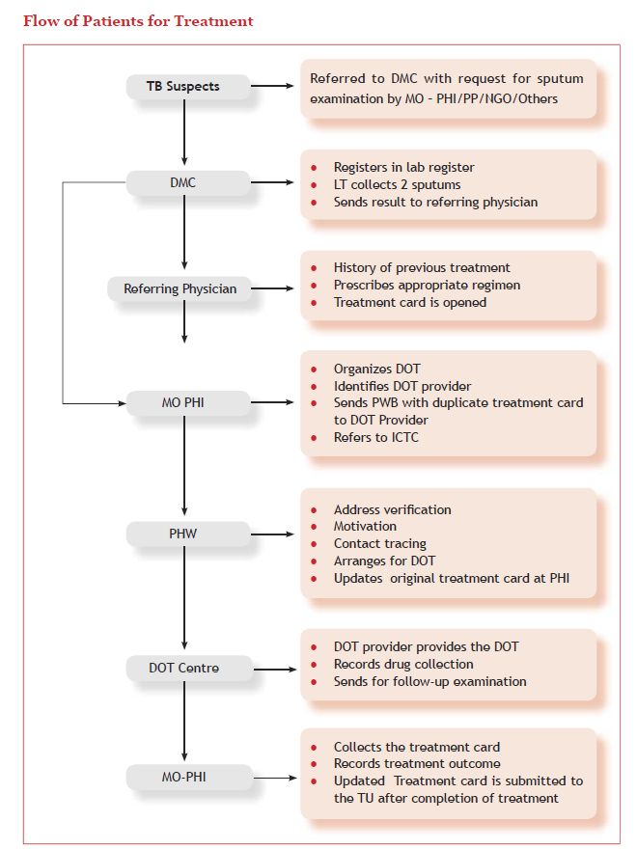

Slide 26
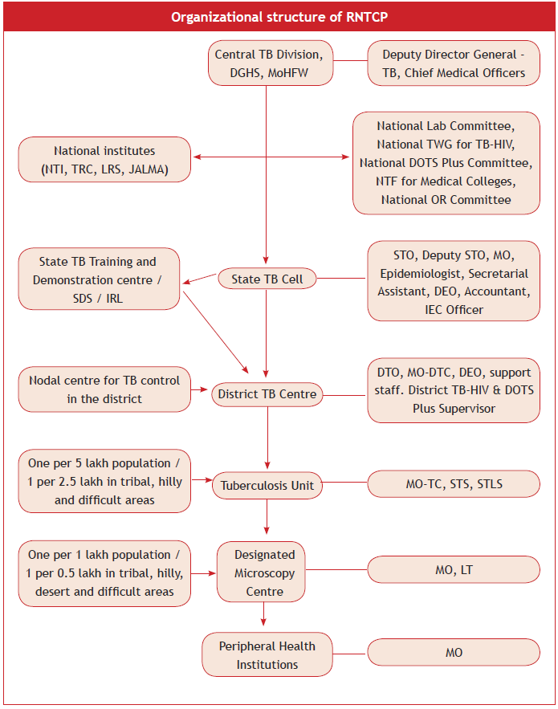

Slide 27
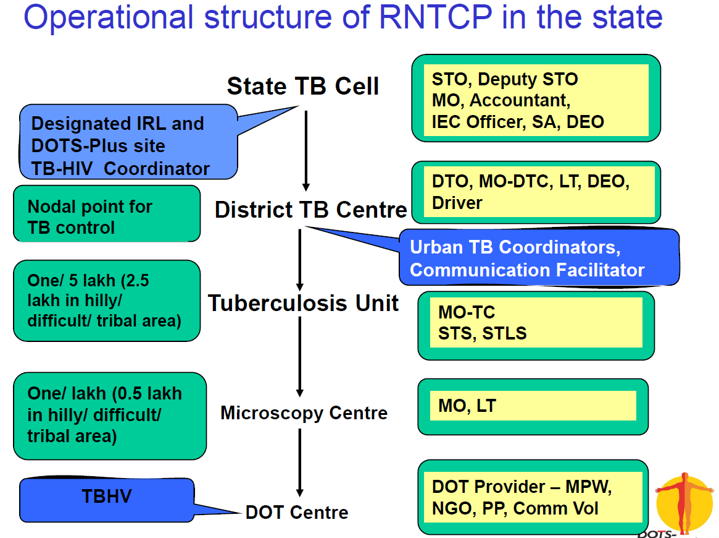

Slide 28
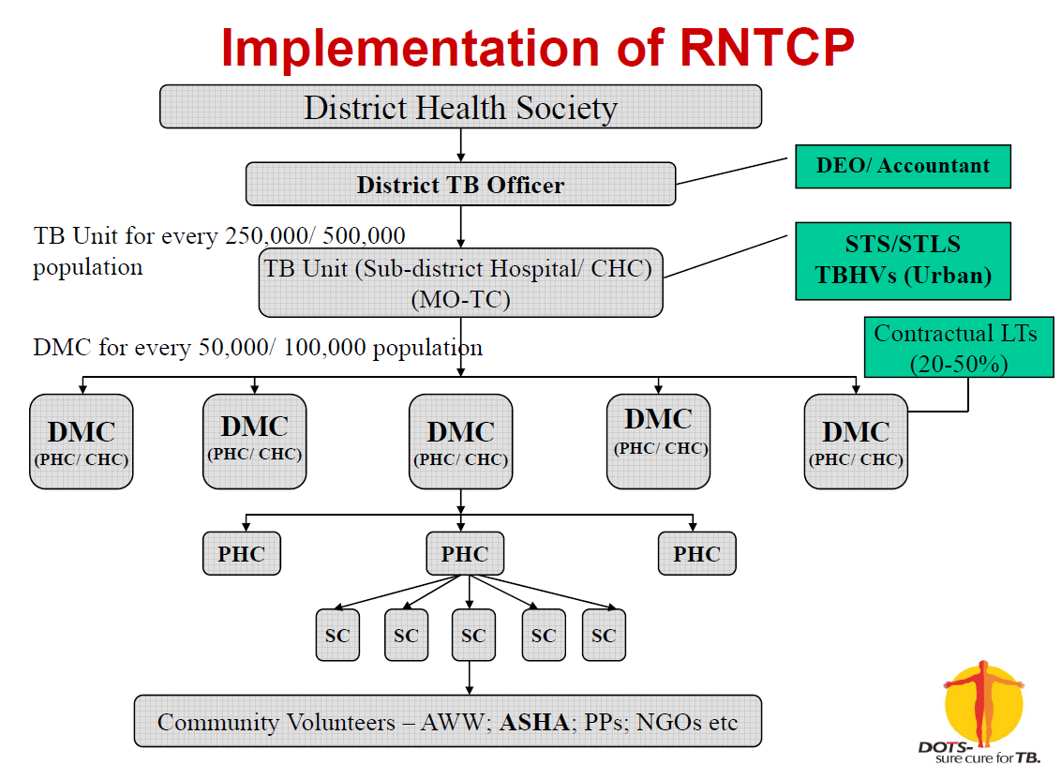

Slide 29
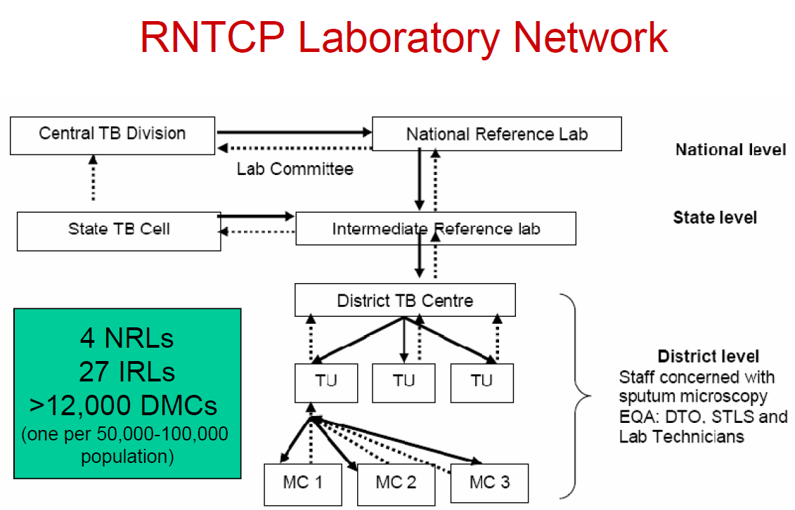

Slide 30
what gets supervised
‘gets done’
Need for continuous supervision & monitoring in order to identify
problems and implement corrective actions

Slide 31
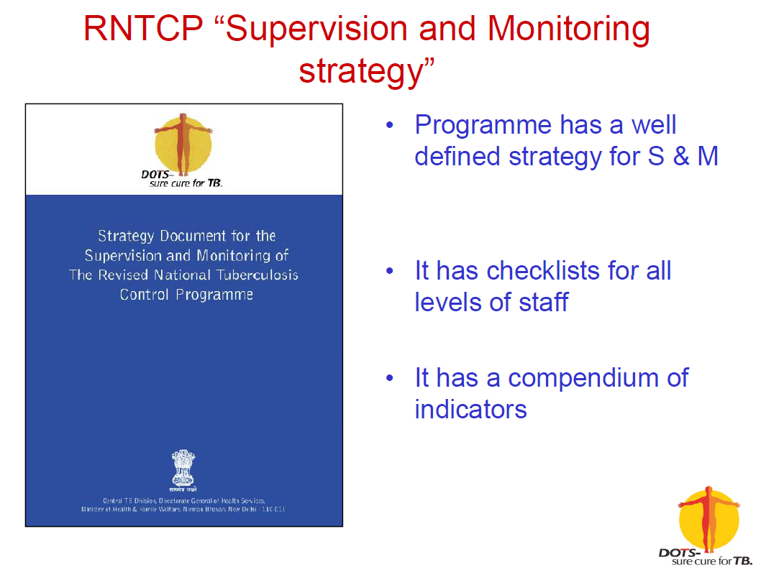

Slide 32
Existing inputs for facilitating supervision
and monitoring
• Clear technical and operational guidelines in RNTCP
• Comprehensive modular training to all staff
• Robust recording/reporting system
• Additional full-time sub-district level supervisory staff
(STS, STLS) with two-wheelers
• Full time district/ state level programme managers
• Adequate funds for mobility/operationalization
• Technical assistance through RNTCP consultants

Slide 33
Essential components of the strategy
1. Supervision
– Protocol for Supervisory visits/ Check list/ Supervisory register
2. Programme surveillance system
– Records/ Reports/ Monitoring indicators
3. Review meetings
– Stated frequency – district-state-national level
– Programme review checklist for CMO/ DM; DHS/ HS
4. Evaluations
– Internal – 2 districts per state per quarter; 1 state per month by
Central team
– External – Joint Monitoring Mission; every 3 years

Slide 34
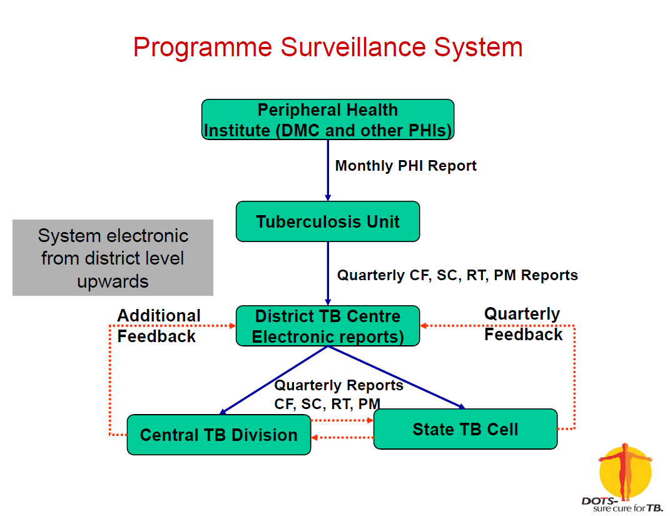

Slide 35
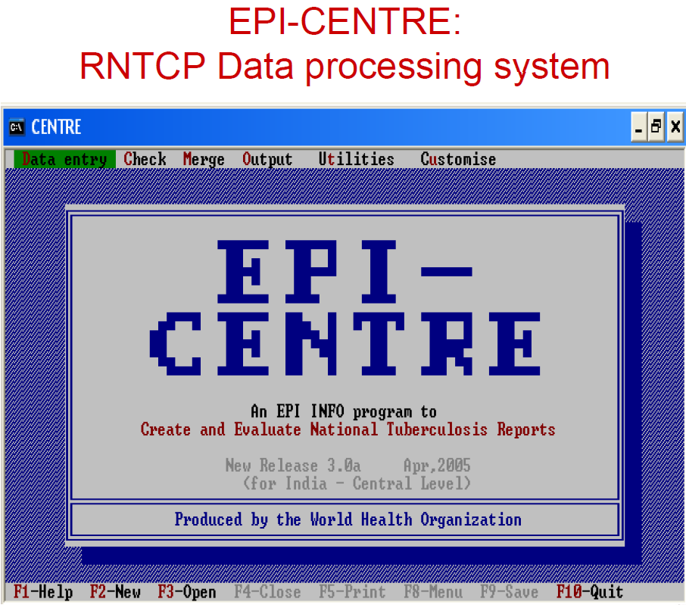

Slide 36
External Evaluations undertaken
• Joint Monitoring Mission (JMM) by WHO and other development
partners in 2000, 2003 and 2006
• Conclusions
– JMM 2000
• RNTCP is succeeding and its results have been excellent
– JMM 2003
• Extra-ordinarily rapid expansion of the programme & highly
economical
– JMM 2006
• Excellent system of recording & reporting with indicators for
monitoring & evaluation; well integrated into general health
system
• Future plan
– JMMs planned in 2009 and 2012

Slide 37
TB/HIV collaborative activities
• TB/HIV Action Plan - implemented by RNTCP and NACP
jointly, focusing on:
– Training of service providers
– Service delivery linkages
– Monitoring
– Information, Education, and Communication
• Implementation started:
– in 2001, in 6 high HIV prevalent States (population 311 million)
– expanded in 2004, to 8 additional States (population 323 million)
– New TB-HIV National framework in 2008 and under this the
entire country is covered.

Slide 38

Achievements of
rntcp

Slide 39
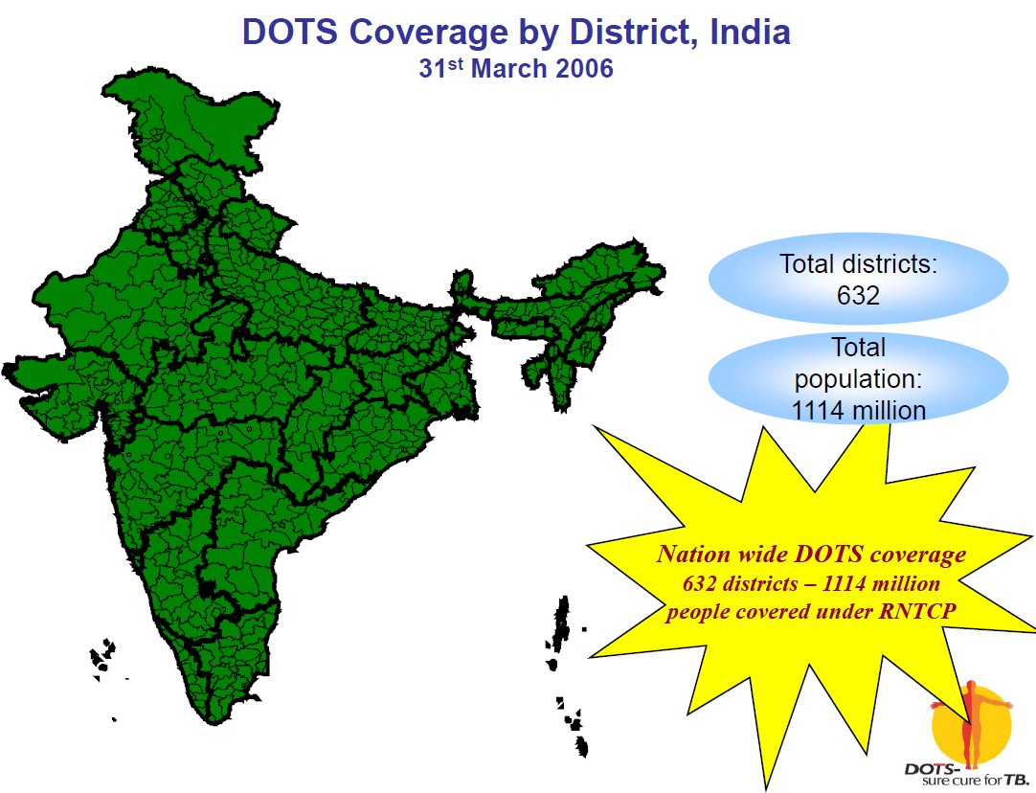

Slide 40
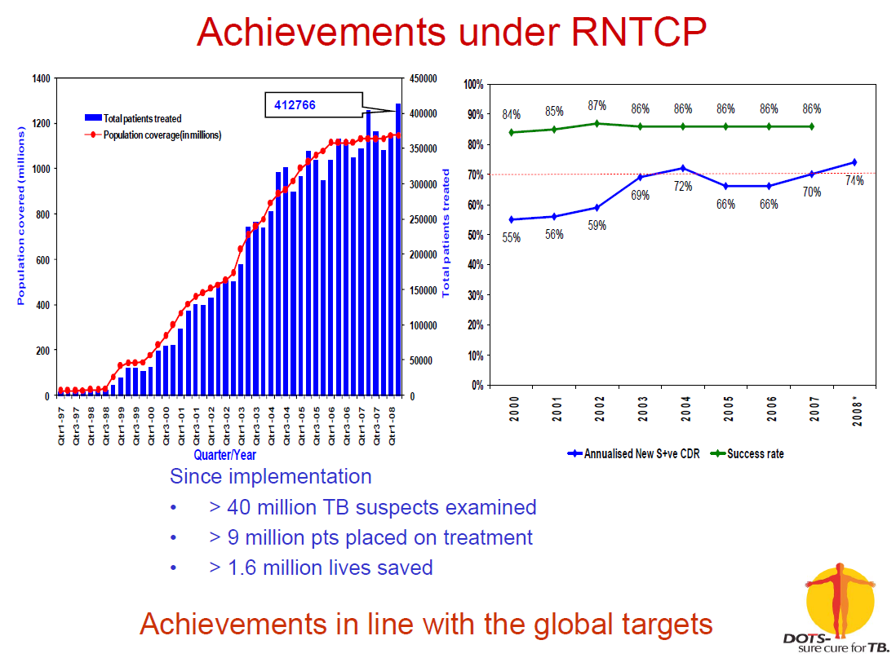

Slide 41
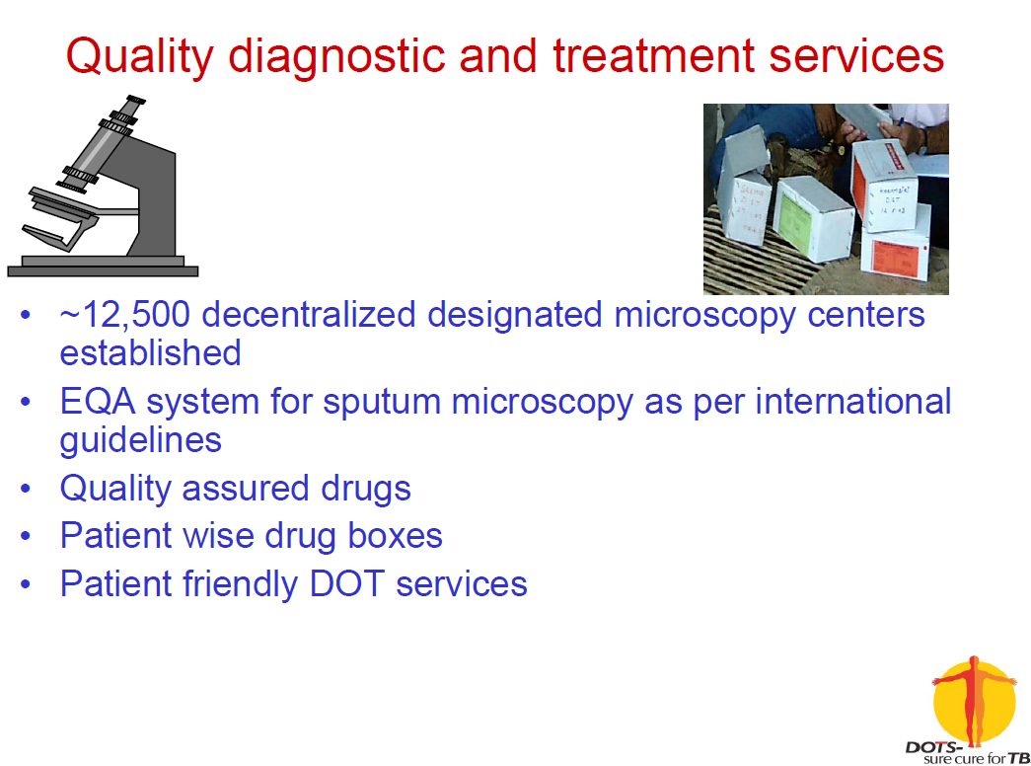

Slide 42
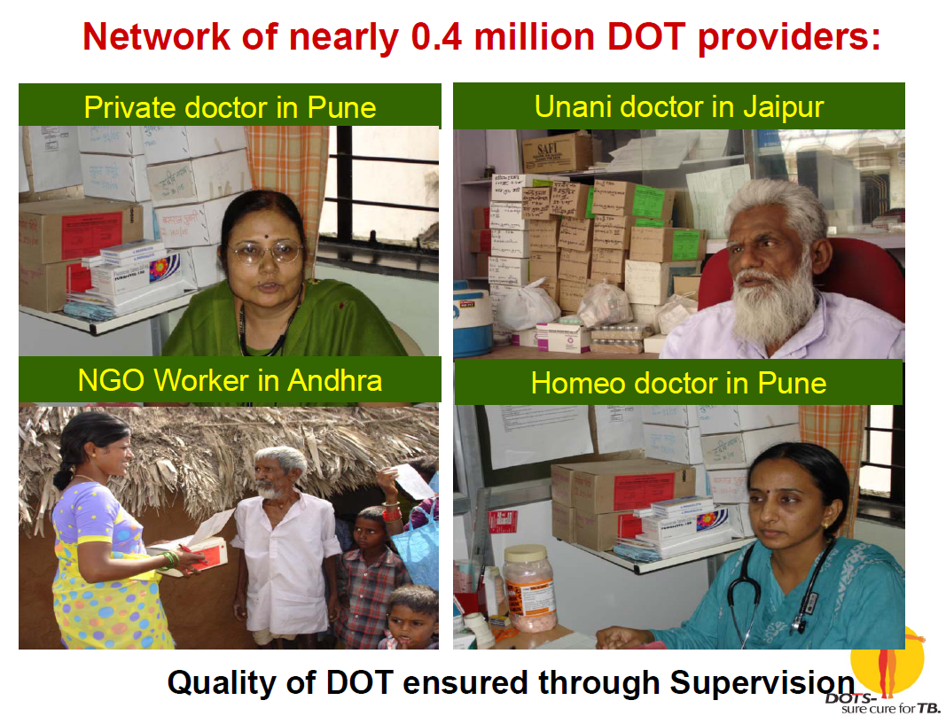

Slide 43
Challenges
Achieving universal access while maintaining and further
improving the quality of services across the country
Continued motivation of human resources to perform optimally
and maintaining the efficiency levels.
Promoting rational use of first line and second line anti-TB
drugs outside the programme for prevention of MDR and XDR
TB
Scaling up culture & DST and treatment services for MDR-TB.
Scaling up of PPM activities to link all providers to the national
programme
TB-HIV collaboration
Promote operational research to address the local challenges
Introduction of new tools for diagnosis and drugs for treatment

Slide 44
Future plan
• Maintaining/improving quality and reach of DOTS
• Scaling up of MDR-TB management
• Engaging all care providers
• Promoting community involvement and ownership
• Further strengthening TB-HIV collaborative activities
• Introduction of newer diagnostics

Slide 45
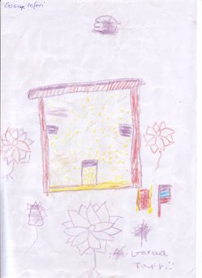

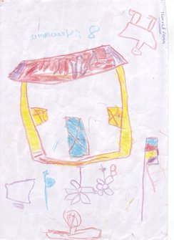
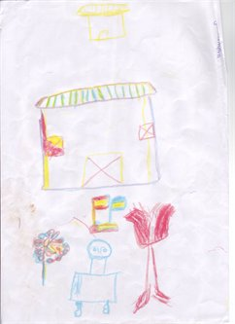
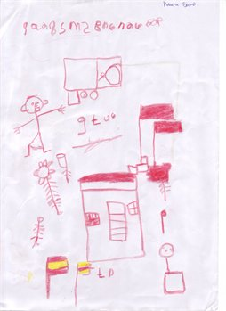

Slide 46


